Slide 1
Module 1 Windows Architecture
Section 1 – Core OS Components

Slide 2
.
Part 1 – General Architecture
Learning Objectives
Have a basic understanding of Kernel architecture
Identify the main components
Have an understanding of key kernel concepts

Slide 3
Windows History
All modern releases of Windows are based on the NT kernel
Quick History
Starts with the NT branch, first released in July 1993
Windows NT 4.0 - August 24, 1996
Windows 2000 - February 17, 2000
Windows XP - October 25, 2001
Windows Vista - November 30, 2006
Windows 7 - October 22, 2009
Windows 8 - October 26, 2012
Windows 8.1 - October 18, 2013
Windows 10 - July 29, 2015

Slide 4
Windows Layered model
SYSTEM PROCESSES
SERVICES
APPLICATIONS
ENVIRONMENT SUBSYSTEMS
Windows OS defines 2 modes of operation
User mode
Where applications and most of services reside
Hardware prevent user mode applications from directly accessing devices and memory, providing security and isolation
Problems in user mode can always be recovered
Kernel mode
Only Kernel mode can actually access the hardware and configure the platform
Limited recoverability
The model is the guarantee for system stability, security and ability to fairly share resources amongst users
User
NTDLL.DLL
Kernel
SYSTEM SERVICE DISPATCHER
Object Mgr
Security Reference Monitor
Memory Manager
Scheduler
I/O Manager
Graphics
Filesystems
KERNEL
HAL

Slide 5
User-mode key components
System processes
Provide some highly critical services that do not require kernel mode
Examples:
Lsass.exe : Stores and enforces security policy; protect users’ credentials; implements security protocols like Kerberos, NTLM and SSL/TLS
Winlogon.exe : Drives user logon process
Services.exe : Control execution of Windows services
Services
An application which provides any kind of service but does not require interaction with user
Examples:
Printing service, file sharing, web server, Windows Update
Subsystems
Provide support to implement a specific environment (e.g. Posix or OS/2)
Mostly a legacy notion in recent versions of Windows
Initially, was developed to allow portability of applications (e.g. allow applications designed for Unix or OS/2 to build and run on Windows)
NTDLL
Handles the transition between user mode and kernel mode. Selects the target Executive service and prepare the thread for entering Kernel mode (syscall)

Slide 6
Kernel-mode key components
System Service dispatcher
General entry point after a thread requested Kernel-mode. Will read the requested Executive service ID and transfer control to it.
Executive
Base operating system high-level services (e.g. I/O manager, memory manager, object manager)
Kernel
Most basic and lowest level services of the operating system like scheduling, synchronization and processor management.
Hardware Abstraction Layer
Provide an abstracted way to access platform and hardware specific features so that upper level components do not depend on a specific computer architecture

Slide 7
Windows for Developers
User-mode Application developers will use Windows SDK
Documentation of Windows API
Can integrate with Visual Studio IDE
Documents System APIs like Security, Cryptography, Storage, Network, …
Driver developers will use Windows DDK
Documentation of Executive and Kernel API

Slide 8
Windows Debugger
Microsoft ships several debuggers
WinDbg and WinDbgX are graphical debuggers. WinDbg being the historical release and WinDbgX being the new version (Universal Application)
Ntsd and Cdb are command line debugger
Kd is the kernel debugger (Kernel debugger is included in the kernel but disabled by default)
Debuggers runs locally or remotely
Kd supports remote debugging only
Transport supported: serial port, FireWire, USB 2 with special cables, USB 3, Ethernet (using compatible network card)

Slide 9
Fundamental concepts to understand
Multitasking
Preemption
Interruptions
Virtual Memory

Slide 10
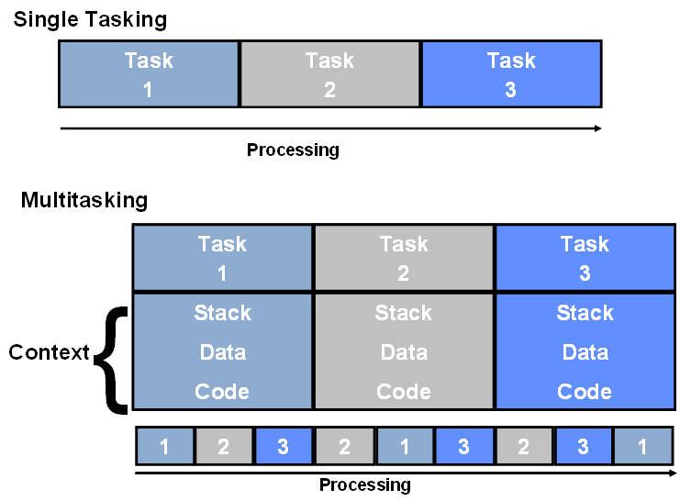
Multitasking
This is the simultaneous execution of more than one program or task
Tasks switching in Windows:
Freeze outgoing task
Save all of the registers of the outgoing task
Load the registers of the incoming task
Continue with incoming task
This process enables the proper address space for the incoming task
Called “Context Switching”

Slide 11
Preemptive vs. Non-preemptive Multitasking
Preemptive | Non-preemptive
OS can take control of the processor with a tasks cooperation | Use of the processor is never taken from a task
Pre-emption | Task must yield the processor
Time on the processor is given in quantums or time slices | Time on the processor taken until yielded
Tasks can be interrupted | Tasks must be specially written to cooperate
Higher priority tasks get control of the processor – interrupting lower priority tasks | Crashed tasks can cause the whole system to hang
Windows NT Family | Windows Millennium was the last version of Windows to use non-preemptive multitasking

Slide 12
Interruptions
A condition where processor will stop executing the normal instructions flow and force a new execution flow based on the context
Various kind of interruptions:
Exceptions : Occurs as a result of software execution errors or when processor cannot continue executing current instruction flow (divide error, invalid virtual address, breakpoint, …)
External Interruptions : Are generated by system logic in response to an error or some other event outside the processor
Software Interruptions : Occurs as a result of executing the interrupt instruction.
Each interruption has a specific numeral code
For instance, divide-by-zero is 0
Processor uses the IDT – Interrupt Dispatch Table and the interrupt code to locate an Interrupt Routine
Routine will handle the interrupt. Most of the time, the real work will be queued for later processing so that normal execution can resume as soon as possible.
Then, routine will restore the context of the interrupted instruction flow and resume normal operation

Slide 13
Virtual Memory
User mode applications do not access physical memory directly
These applications only manipulate virtual addresses which are valid only in their own VAD – Virtual Address Space
Physical memory is split into fixed size elementary units called pages
Memory Management in modern operating systems consists in a strong collaboration between
Hardware : Most modern CPU provide a unit called MMU which will perform the translation between virtual addresses and physical addresses
Software : OS Memory Manager programs the MMU

Slide 14
.
Part 2 – Main Kernel Services
Learning Objectives:
Have an understanding of the core Windows services
Process & Threads
Memory Manager
Object Manager
I/O System

Slide 15
Processes & Threads

Slide 16
Process
Process
In the simplest terms, a process is a program that the operating system is running
An application consists of one or more processes
A process has
Its own memory area
Called a "virtual address space"
Executable code
Open resources (or "handles") to system objects e.g. files
A security context
A unique process identifier
Environment variables
A priority class to determine how resources are allocated
Minimum and maximum working set sizes (memory)
At least one "thread" of execution

Slide 17
Process Internals
Processes internal data are stored in EPROCESS structures (data relevant to Executive)
Processes list is implemented by a linked list which head is stored in nt!PsActiveProcessHead global
Process 0
…
Process n
EPROCESS
EPROCESS
Kernel Process Block
Kernel Process Block
UniqueProcessId
UniqueProcessId
OwnerProcessId
OwnerProcessId
ActiveProcessLinks
ActiveProcessLinks
CreateTime
CreateTime
ExitTime
ExitTime
ObjectTable
ObjectTable
nt!PsActiveProcessHead

Slide 18
Viewing currently running processes
kd> !process 0 0
**** NT ACTIVE PROCESS DUMP ****
PROCESS ffff890584a73440
SessionId: none Cid: 0004 Peb: 00000000 ParentCid: 0000
DirBase: 001ca000 ObjectTable: ffff998961615000 HandleCount: 2028.
Image: System
PROCESS ffff890584b74040
SessionId: none Cid: 0058 Peb: 00000000 ParentCid: 0004
DirBase: 03f40000 ObjectTable: ffff99896163d000 HandleCount: 0.
Image: Registry
PROCESS ffff89058613a040
SessionId: none Cid: 0134 Peb: 139aac0000 ParentCid: 0004
DirBase: 00b40000 ObjectTable: ffff998961b81080 HandleCount: 52.
Image: smss.exe
PROCESS ffff8905870c2580
SessionId: 0 Cid: 0198 Peb: 27d65f1000 ParentCid: 0190
DirBase: 0bc80000 ObjectTable: ffff998961e53ac0 HandleCount: 317.
Image: csrss.exe
PROCESS ffff890587775580
SessionId: 0 Cid: 01e4 Peb: 4b6be9f000 ParentCid: 0190
DirBase: 11540000 ObjectTable: ffff998962924280 HandleCount: 155.
Image: wininit.exe
PROCESS ffff890587783580
SessionId: 1 Cid: 01f0 Peb: 256d48d000 ParentCid: 01dc
DirBase: 0ec80000 ObjectTable: ffff99896293b280 HandleCount: 344.
Image: csrss.exe
PROCESS ffff8905877cc080
SessionId: 1 Cid: 0248 Peb: e92baea000 ParentCid: 01dc
DirBase: 10ec0000 ObjectTable: ffff998962959740 HandleCount: 244.
Image: winlogon.exe
Using various utilities
TaskMgr.exe, tasklist.exe, processexp.exe
Using the Debugger
Use the !process command
"Cid" (client ID) is the Process ID
"Peb" is the address of the process environment block

Slide 19
Thread
Part of a process
Every process has at least one thread
Threads share some of their process properties
Virtual Memory
System resources
A thread context includes:
The thread's set of machine registers
The kernel stack
A thread environment block
A user stack in the address space of the thread's process.
Threads can have their own security context, which can be used for "impersonating" clients
Threads are scheduled pre-emptively (more later)
On multiprocessor systems several threads can run at same time

Slide 20
Thread Internals
Thread internal data are stored in ETHREAD structures (data relevant to Executive)
Threads list is implemented as a linked list
Thread 0
Process n
ETHREAD
EPROCESS
Kernel Thread Block
Kernel Process Block
CreateTime
Thread n
ThreadListHead
ExitTime
ETHREAD
StartAddress
UniqueProcessId
Kernel Thread Block
ThreadListEntry
OwnerProcessId
CreateTime
ActiveProcessLinks
ExitTime
CreateTime
StartAddress
ExitTime
ThreadListEntry
ObjectTable

Slide 21
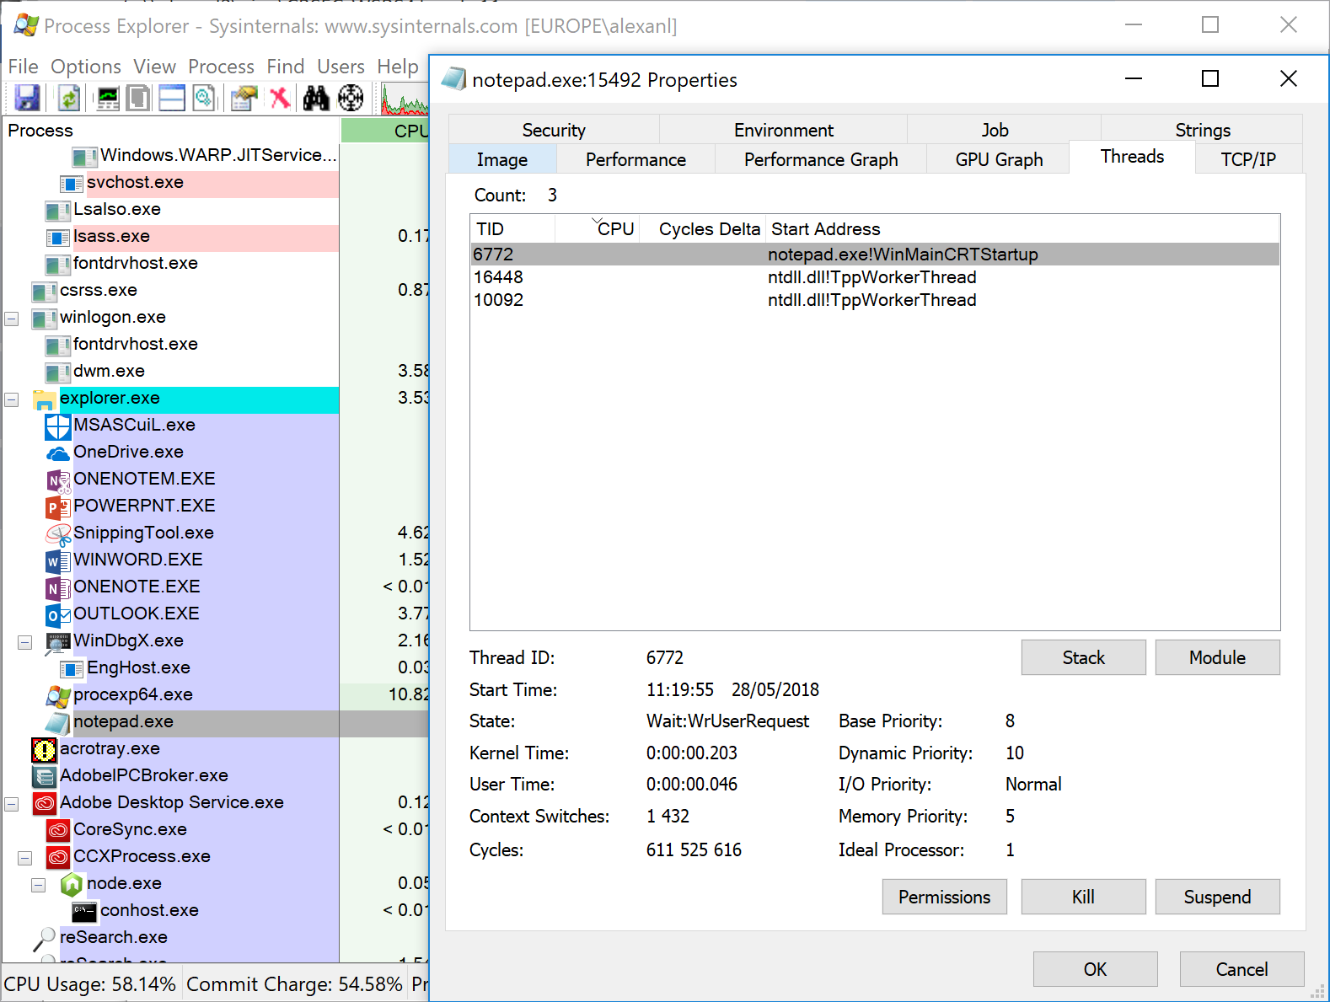
Viewing process’ threads
Using Process Explorer

Slide 22
Viewing process’ threads using the debugger
Use !process EPROCESS_address 3
Dumps basic process and threads information
Cid is in the form ProcessID.ThreadID
Thread info contains Ethread address, Thread environment block mode and state
0: kd> !process ffff890585214580 3
PROCESS ffff890585214580
SessionId: 1 Cid: 1140 Peb: c10d10e000 ParentCid: 0fc4
DirBase: 33c80000 ObjectTable: ffff9989644d7040 HandleCount: 590.
Image: powershell.exe
VadRoot ffff890587b7d010 Vads 218 Clone 0 Private 5573. Modified 86. Locked 0.
DeviceMap ffff998962921410
Token ffff998963abca70
ElapsedTime 3 Days 20:53:53.913
UserTime 00:00:00.062
KernelTime 00:00:00.078
QuotaPoolUsage[PagedPool] 539720
QuotaPoolUsage[NonPagedPool] 30544
Working Set Sizes (now,min,max) (17202, 50, 345) (68808KB, 200KB, 1380KB)
PeakWorkingSetSize 19115
VirtualSize 2101940 Mb
PeakVirtualSize 2101944 Mb
PageFaultCount 45055
MemoryPriority BACKGROUND
BasePriority 8
CommitCharge 14421
THREAD ffff89058552d080 Cid 1140.116c Teb: 000000c10d10f000 Win32Thread: ffff8905878df810 WAIT: (UserRequest) UserMode Alertable
ffff890585fc05e0 NotificationEvent
THREAD ffff890584fe5500 Cid 1140.1350 Teb: 000000c10d115000 Win32Thread: ffff89058516aea0 WAIT: (WrQueue) UserMode Alertable
ffff890587bd7200 QueueObject

Slide 23
Jobs and Fibers
Jobs and Fibers are less used scheduling mechanisms
Jobs
A job object allows groups of processes to be managed as a unit. Job objects are namable, securable, sharable objects that control attributes of the processes associated with them. Operations performed on a job object affect all processes associated with the job object. Examples include enforcing limits such as working set size and process priority or terminating all processes associated with a job.
Fibers
A fiber is a unit of execution that must be manually scheduled by the application. Fibers run in the context of the threads that schedule them. Each thread can schedule multiple fibers. In general, fibers do not provide advantages over a well-designed multithreaded application. However, using fibers can make it easier to port applications that were designed to schedule their own threads.

Slide 24
Scheduling
Windows schedules threads, not processes
Scheduling is pre-emptive, priority-based, and round-robin at the highest-priority
There are 16 real-time priorities above 16 normal priorities
Most applications run in the normal priority range
Scheduler tries to keep a thread on its ideal processor to avoid performance degradation of cache/NUMA-memory
Threads can specify an "affinity" to run only on certain processors
Each thread has a current & base (started at) priority
The base priority of a thread is initially set from the owning process
Non-real-time threads (normal ones) can have their priority boosted/reduced from their base
Boosts are given for being in GUI foreground, or waking to handle some event
Priority decays, particularly if thread is "CPU bound" [see note]
The Scheduler is state-driven by timer, setting thread priority, thread block/exit, etc.
Priority inversions can lead to starvation
Balance manager periodically boosts non-running runnable threads

Slide 25
Scheduler
How does a thread get its priority?
A thread priority is assigned at creation
Real-Time
High
Above Normal (Norm+)
Normal
Below Normal (Norm -)
Idle
Each thread also has a relative priory within its process
Again at 5 levels
With dynamic threads
Windows can raise or lower priorities in response to events

Slide 26
Thread priorities
32 Priority levels
Level 0 is used by the Zero Page Thread
Levels 1 – 15 are the dynamic range
Levels 16 – 31 are the real time range
31
16 real time levels
16
15
15 dynamic levels
1
0
Zero page thread only

Slide 27
Thread dispatching
Process
Process
Threads ready to execute are referenced in a per-CPU list
Each CPU maintains a list for each 32 priority levels
When there are multiple cores in a single CPU unit, the list is shared between the cores
Better performances as it reflects system architecture
Thread
Thread
Thread
Thread
CPU 0
Ready queues
CPU 1
Ready queues
31
31
0
0

Slide 28
Viewing Ready threads using the debugger
kd> !ready
KSHARED_READY_QUEUE fffff8026bfcc700: (00) **--------------------------------------------------------------
SharedReadyQueue fffff8026bfcc700: Ready Threads at priority 8
THREAD ffff890584f0d080 Cid 17fc.03d8 Teb: 00000047dc0e9000 Win32Thread: ffff890584af61a0 READY on processor 80000000
SharedReadyQueue fffff8026bfcc700: Ready Threads at priority 7
THREAD ffff890587a68700 Cid 05c8.05e8 Teb: 0000000000000000 Win32Thread: 0000000000000000 READY on processor 80000000
SharedReadyQueue fffff8026bfcc700: Ready Threads at priority 6
THREAD ffff890584b9c040 Cid 0004.07a4 Teb: 0000000000000000 Win32Thread: 0000000000000000 READY on processor 80000000
SharedReadyQueue fffff8026bfcc700: Ready Threads at priority 0
THREAD ffff890584b6e040 Cid 0004.0038 Teb: 0000000000000000 Win32Thread: 0000000000000000 READY on processor 80000001
Processor 0: Group Scheduling Queue
Scb: ffff8905886ef4b0 Rank: 1 OQHistory: 5555555555555555
GenCycles: 0 LTCycles: 0, MinTarget: 1844400000, MaxTarget: 1844400000, RankTarget: 0
nt!_KSCB ffff8905886ef4b0: Ready Threads at priority 8
THREAD ffff8905851c5080 Cid 1490.1488 Teb: 0000006cd4d97000 Win32Thread: ffff8905874fa400 READY on processor 0
THREAD ffff890585ffa080 Cid 1490.0e1c Teb: 0000006cd4daf000 Win32Thread: 0000000000000000 READY on processor 0
Processor 1: Group Scheduling Queue
Scb: ffff8905886ef658 Rank: 1 OQHistory: 5555555555555555
GenCycles: 0 LTCycles: 0, MinTarget: 1844400000, MaxTarget: 1844400000, RankTarget: 0
nt!_KSCB ffff8905886ef658: Ready Threads at priority 9
THREAD ffff8905884b6700 Cid 1490.0cbc Teb: 0000006cd4d9f000 Win32Thread: 0000000000000000 READY on processor 1
nt!_KSCB ffff8905886ef658: Ready Threads at priority 8
THREAD ffff890585043080 Cid 1490.0a90 Teb: 0000006cd4da1000 Win32Thread: 0000000000000000 READY on processor 1

Slide 29
Notification routines
Notification routines allow services running in Kernel mode to be notified when a new process/thread is created
Routines called when new process/thread is created
PspCreateThreadNotifyRoutine
Array of routines to be called when new thread is created
PspCreateProcessNotifyRoutine
Array of routines to be called when new process is created

Slide 30
Memory Manager

Slide 31
Virtual Memory Management
The amount of memory a process can address does not directly relate to the amount of physical RAM
Pages
The unit of memory management
Page Files (Virtual RAM)
Paging technology allows OS to offer more virtual address space than there is with physical RAM
Pages from some applications are "swapped" to disk
Allows space in physical RAM to become available for other pages
Page files are sometimes referred to as "swap files"
More pages of virtual memory can be allocated than physical memory
The amount of usable paged memory depends on:
The amount of physical RAM
Speed of the paging disk
Nature of the applications and their working sets

Slide 32
Pagination Example
Process 0
Physical Memory
Process 1
Kernel
4 kB
Page
Kernel
Code Page
Code Page
Page
Code Page
Page
Code Page
Data Page
Page
Data Page
Virtual Address Space
Specific to process 0
Virtual Address Space
Specific to process 1
Stack Page
Page
Stack Page
Page
Page
Page
Page

Slide 33
Windows Memory Manager core responsibilities
Provide memory services
Allocates, frees memory sections. Implements file mappings, memory sharing and copy-on-write functionalities.
Configure Memory Management Unit
Appropriately create and maintain memory structures used by the processor’s MMU so that when a thread running in the context of a particular process reads or writes to the virtual address space, the correct physical address is referenced
Swap memory pages to/from disk storage
When running threads or system code trying to use more physical memory than available, pages out unused memory pages to disk and brings the content back when needed

Slide 34
Services provided by Memory Manager
Allocate and free virtual memory
Share memory between processes
Map files into memory
Flush virtual pages to disk
Get information about pages
Set security and protection on pages
Lock pages into memory

Slide 35
Page Size
Memory allocation defaults to using Small pages
Application can choose Large pages to lower memory translation costs
Architecture | Small Page Size | Large Page Size
x86 | 4 kB | 4 MB (2 MB on PAE systems)
amd64 | 4 kB | 2 MB
IA64 | 8 kB | 16 MB

Slide 36
Page database
Each physical page is identified by its PFN – Page Frame Number
PFN is simply the address of the page in physical memory. Because pages are generally 4kb, any PFN has the lowest 12 bits set to 0. (2¹²=4096)
Memory Manager maintains an index of pages for storing page meta-data
Details on a page can be obtained by the debugger command !pfn page_frame_number

Slide 37
From virtual addresses to physical addresses
All process and system code manipulate VA – Virtual Addresses
When CPU executes an instruction containing an address, MMU translates it to physical address
For performance reason, already translated addresses are cached into the TLB – Translation Lookaside Buffer
MMU is configured using a number of CPU-specific structures. Intel CPUs use the CR3 register to access the root of that configuration
Process
System
VA Virtual Addresses
TLB
MMU
VA Virtual Addresses
Memory

Slide 38
Translation process (x86)
Each process has 1 page directory. Address is stored in the KPROCESS structure. Windows loads this address (physical) in the CR3 register
Processor will look at the page directory and load entry (PDE) offset by the highest 10 bits (Page Directory Index) of the virtual address. Page directory entry contains physical address of a page table.
Processor will look at the page table and load entry (PTE) offset by the next 10 bits (Page Table Index) of the virtual address. Page table entry contains the start address of a page in physical memory
Processor will look at the page pointed by the PTE offset by the 12 lowest bits of the virtual address.
Physical address obtained through this process is the result of the translation.

Slide 39
Memory translation (x86)
Virtual addresses (32 bits) are split into 3 parts
Page Directory Index
Page Table Index
Byte Index

Slide 40
Translation process (amd64)
Each process has 1 page map level 4 table. Address is stored in the KPROCESS structure. Windows loads this address (physical) in the CR3 register
Processor will look at the page map level 4 pointed by CR3 and load entry (PML4E) offset by the highest 9 bits (Page Map Level 4 Index) of the virtual address. Entry contains physical address of a page directory pointer table.
Processor will look at the page directory pointer table and load entry (PDPE) offset by the next 9 bits (Page Directory Pointer Index) of the virtual address. Entry contains physical address of a page directory.
Processor will look at the page directory and load entry (PDE) offset by the next 9 bits (Page Directory Index) of the virtual address. Entry contains physical address of a page table.
Processor will look at the page table and load entry (PTE) offset by the next 9 bits (Page Table Index) of the virtual address. Entry contains physical address of a page.
Processor will look at the page pointed by the PTE offset by the 12 lowest bits of the virtual address.
Physical address obtained through this process is the result of the translation.

Slide 41
Memory translation (amd64)
Virtual addresses (64 bits) are split into 5 parts
Page-map level 4 Index
Page Directory Pointer Index
Page Directory Index
Page Table Index
Byte Index

Slide 42
Displaying details of the address translation process
The !pte debugger command followed by a VA describes the process of address translation
Example of translating VA 0x000000c1`0d5ff758 to PA 0x00000000`36781758
kd> !pte 000000c1`0d5ff758
VA 000000c10d5ff758
PXE at FFFFF9FCFE7F3008 PPE at FFFFF9FCFE601820 PDE at FFFFF9FCC0304350 PTE at FFFFF9806086AFF8
contains 0A0000002C77E867 contains 0A000000192FF867 contains 0A00000031298867 contains 8000000036781967
pfn 2c77e ---DA--UWEV pfn 192ff ---DA--UWEV pfn 31298 ---DA--UWEV pfn 36781 -G-DA--UW-V

Slide 43
Kernel-Mode memory allocation
Kernel-Mode memory allocations comes from 2 kinds of Pools
Nonpaged Pool : Regions of virtual memory in the system space that are guaranteed to reside in physical memory at all time. Can be accessed at any time, any IRQL
Paged Pool : Regions of virtual memory in the system space that can be paged out of the system
System starts with 1 Nonpaged Pool and 4 Paged Pools
More paged pools might be created depending on number of physical CPU & system architecture

Slide 44
Memory Pool tagging
To track Kernel-mode memory leaks, memory pool allocations are tagged with a 4-byte code
Usually, the 4 bytes are taken from ASCII alphanumeric character set to ease reading
Displaying Pool allocation surrounding VA 0xffff8905880f3080
kd> !pool ffff8905880f3080
Pool page ffff8905880f3080 region is Nonpaged pool
*ffff8905880f3000 size: 970 previous size: 0 (Allocated) *Thre
Pooltag Thre : Thread objects, Binary : nt!ps
ffff8905880f3970 size: 10 previous size: 970 (Free) Free
ffff8905880f3980 size: 80 previous size: 10 (Allocated) Even
ffff8905880f3a00 size: c0 previous size: 80 (Allocated) FMsl
ffff8905880f3ac0 size: 190 previous size: c0 (Allocated) File
ffff8905880f3c50 size: 80 previous size: 190 (Allocated) Even
ffff8905880f3cd0 size: 60 previous size: 80 (Allocated) Icp
ffff8905880f3d30 size: 60 previous size: 60 (Allocated) Icp
ffff8905880f3d90 size: e0 previous size: 60 (Allocated) EtwR
ffff8905880f3e70 size: 190 previous size: e0 (Allocated) File

Slide 45
Kernel pools size limits
Non-paged Pool limits
 | 32-bit | 64-bit
XP, Server 2003 | up to 1.2GB RAM: 32-256 MB > 1.2GB RAM: 256MB | min( ~400K/MB of RAM, 128GB)
Vista, Server 2008, Windows 7, Server 2008 R2 | min( ~75% of RAM, 2GB) | min(~75% of RAM, 128GB)
Windows 8, Server 2012 | min( ~75% of RAM, 2GB) | min( 2x RAM, 128GB)
Paged Pool limits
 | 32-bit | 64-bit
XP, Server 2003 | XP: up to 491MB Server 2003: up to 650MB | min( 4 * nonpaged pool limit, 128GB)
Vista, Server 2008, Windows 7, Server 2008 R2 | min( system commit limit, 2GB) | min( system commit limit, 128GB)
Windows 8, Server 2012 | min( system commit limit, 2GB) | min( system commit limit, 384GB)

Slide 46
Look-Aside Lists
Another way to allocate memory for Kernel-mode components
Only fixed-size allocations
Better performance compared to Pools
The !lookaside debugger command can display lookaside lists information

Slide 47
Examining Kernel-mode memory usage in the debugger
The !vm command lists current statistics regarding memory usage
Physical Memory
Installed memory in Pages and in Kb
NonPagedPool(Nx)
NonPagedPool usage in Pages and in Kb
PagedPool[0..4]
Paged Pools usage in Pages and in Kb
kd> !vm
Page File: \??\C:\pagefile.sys
Current: 1769472 Kb Free Space: 1696232 Kb
Minimum: 1769472 Kb Maximum: 3234800 Kb
Page File: \??\C:\swapfile.sys
Current: 262144 Kb Free Space: 262136 Kb
Minimum: 262144 Kb Maximum: 1571364 Kb
No Name for Paging File
Current: 4282376 Kb Free Space: 4068652 Kb
Minimum: 4282376 Kb Maximum: 4282376 Kb
Physical Memory: 261894 ( 1047576 Kb)
NonPagedPool Usage: 0 ( 0 Kb)
NonPagedPoolNx Usage: 13486 ( 53944 Kb)
NonPagedPool Max: 4294967296 (17179869184 Kb)
PagedPool 0: 6753 ( 27012 Kb)
PagedPool 1: 1874 ( 7496 Kb)
PagedPool 2: 1876 ( 7504 Kb)
PagedPool 3: 1868 ( 7472 Kb)
PagedPool 4: 1885 ( 7540 Kb)
PagedPool Usage: 14256 ( 57024 Kb)

Slide 48
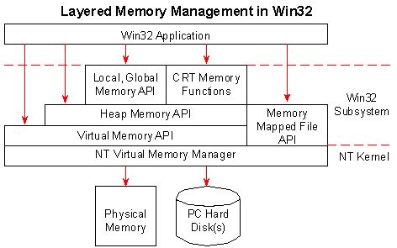
User-mode memory allocation
Memory allocation for User-Mode processes:
Heaps : Collection of memory allocated regions of various size
Mapped Files : Memory region which maps to a file (local or remote)
Notes:
https://channel9.msdn.com/Shows/Going+Deep/Inside-Windows-8-Greg-Colombo-Heap-Manager

Slide 49
Heap Security Features
Heap Manager evolved with time
Taking into account threats in order to have a preeminent role in early detection of Heap usage errors leading to heap-based exploits
Metadata ransdomization
Metadata integrity check
Randomization of base address
Option to terminate process in case of heap corruption
Notes:
Additional resources:

Slide 50
Examining Heap with the debugger (1/2)
The !heap -s command lists all the heaps in use in the current process with summary information
kd> !heap -s
************************************************************************************************************************
NT HEAP STATS BELOW
************************************************************************************************************************
LFH Key : 0x494b5b75645f0e37
Termination on corruption : ENABLED
Affinity manager status:
- Virtual affinity limit 2
- Current entries in use 0
- Statistics: Swaps=0, Resets=0, Allocs=0
Heap Flags Reserv Commit Virt Free List UCR Virt Lock Fast
(k) (k) (k) (k) length blocks cont. heap
-------------------------------------------------------------------------------------
0000024431b30000 00000002 4112 2588 4084 222 124 3 1 1 LFH
0000024431aa0000 00008000 64 4 64 2 1 1 0 0
0000024431e70000 00001002 1108 248 1080 14 15 2 0 0 LFH
00000244337b0000 00001002 88 64 60 24 7 1 0 0 LFH
0000024431e30000 00001002 60 8 60 5 1 1 0 0
0000024433760000 00001002 60 20 60 2 4 1 0 0
0000024433700000 00041002 60 8 60 5 1 1 0 0
000002444bd10000 00041002 88 40 60 3 1 1 0 0 LFH
-------------------------------------------------------------------------------------

Slide 51
Examining Heap with the debugger (2/2)
The !heap -i displays information on a particular address in an allocated region
First, the command is called with a particular Heap handle
kd> !heap -i 0000024431b30000
Next, the command is called with a particular address
kd> !heap -i 000002444c0cb5f0
Detailed information for block entry 000002444c0cb5f0
Assumed heap : 0x0000024431b30000 (Use !heap -i NewHeapHandle to change)
Header content : 0x0D775C48 0x00043CB1 (decoded : 0x02000002 0x0004004A)
Owning segment : 0x000002444c080000 (offset 4)
Block flags : 0x0 (free )
Total block size : 0x2 units (0x20 bytes)
Previous block size: 0x4a units (0x4a0 bytes)
Block CRC : OK - 0x2
Free list entry : OK
Previous block : 0x000002444c0cb150
Next block : 0x000002444c0cb610

Slide 52
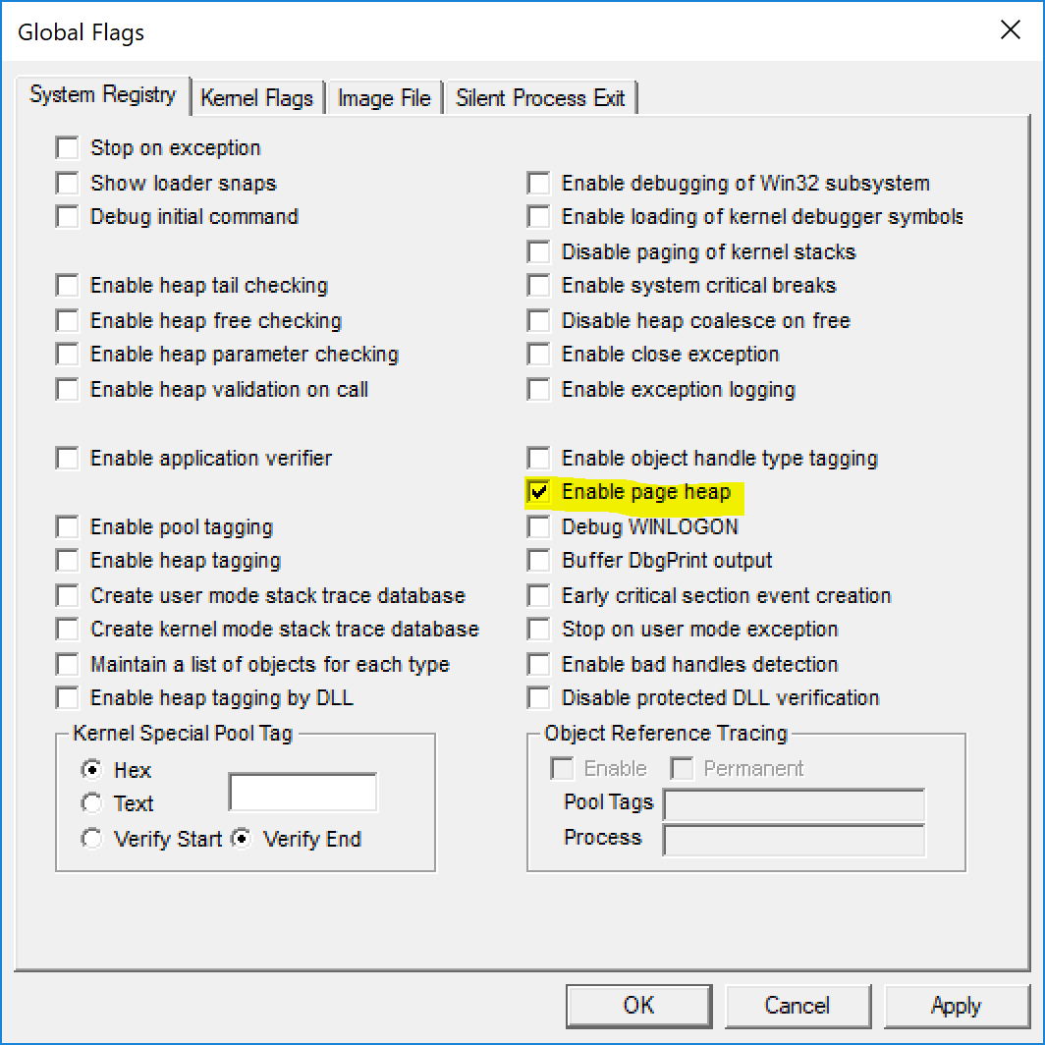
Pageheap
Another security feature
Heap Manager places allocation at the end of pages
When buffer overrun occurs, it will cause an access violation
Enable with GFlags
Enabling Pageheap with the Gflags utility

Slide 53
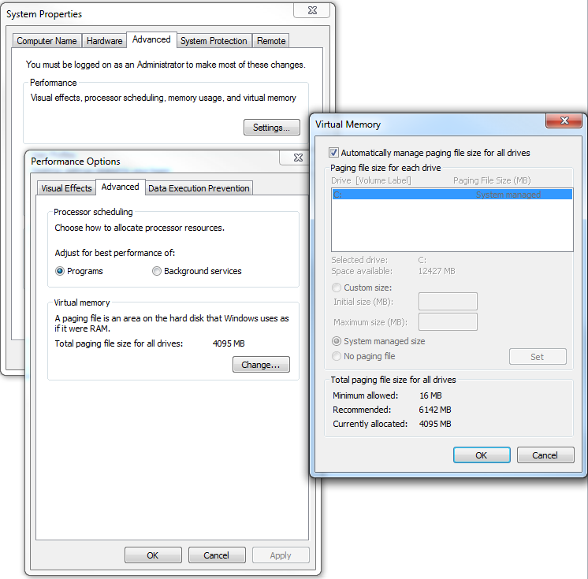
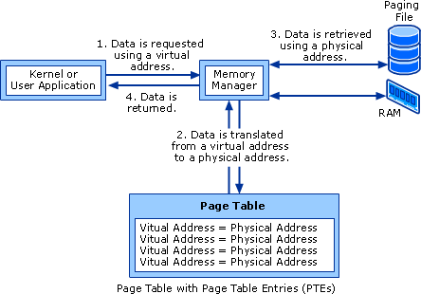
The Pagefile
Little used pages are removed from physical memory and moved to disk
The file which stores the pages is the pagefile
Memory manager handles moving pages back to physical memory when needed

Slide 54
DEP – Data Execution Prevention
Leverages x64 and recent x86 processor ability to mark a page as non-executable
Hardware feature. Require support from processor
The highest bit in MMU descriptor blocks (either PDE, PTE, …) is set to 1 when the page or the underlying page tree is to be marked as NX – Not Executable
Prevent executing code in pages marked as not executable
Kernel-mode : System will crash
User-mode : An access violation exception is generated
64-bit Windows:
DEP is enforced for every processes
Can be disabled by the nx boot-leader option (ie: bcdedit /set nx off)
32-bit Windows:
DEP is enabled for kernel and Windows processes by default (Opt-in policy)

Slide 55
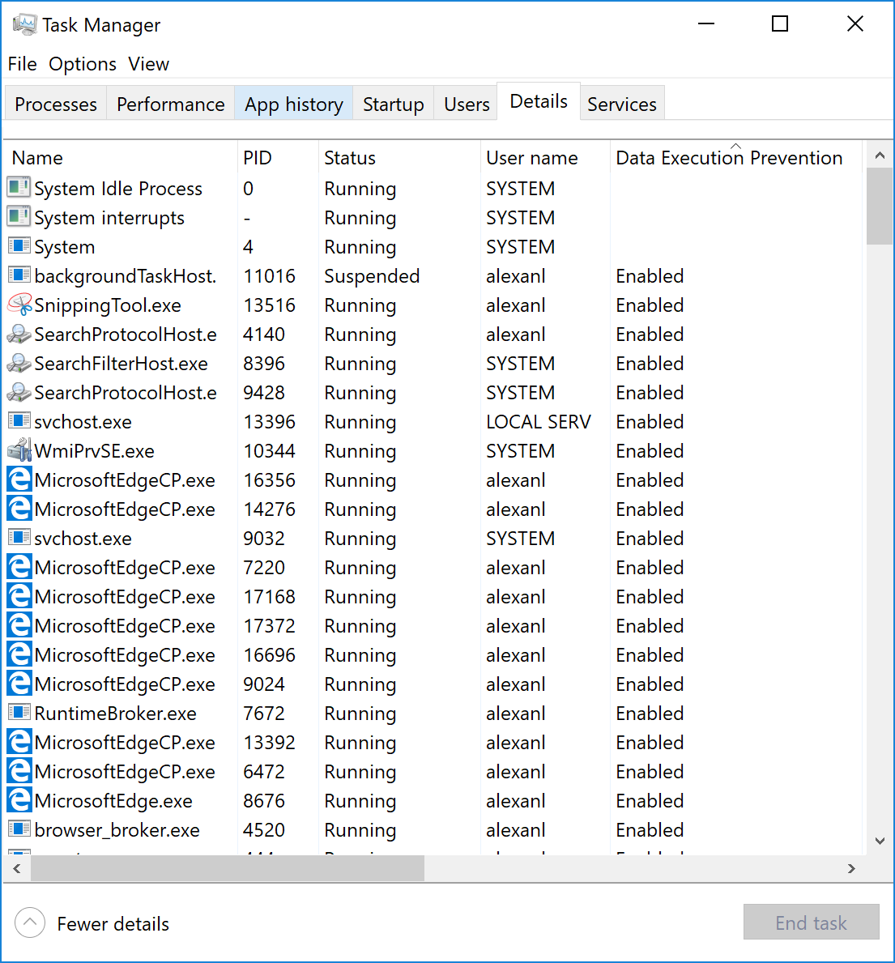
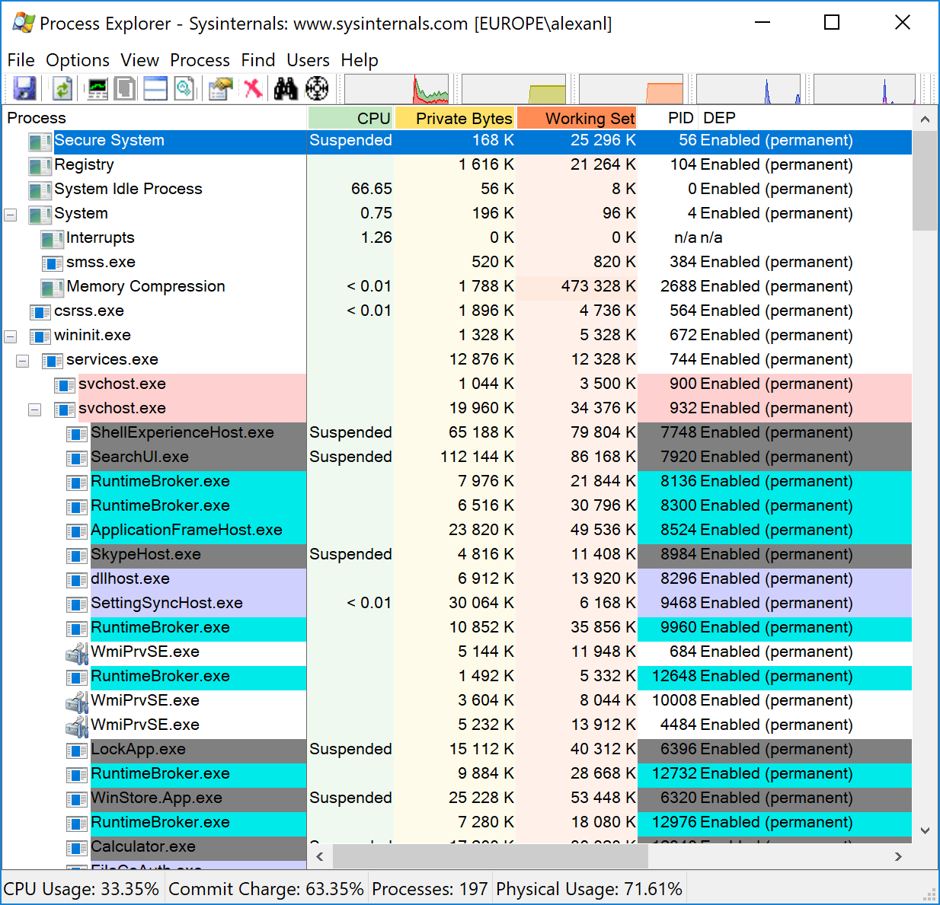
Check DEP status
Using TaskMgr.exe
Using Process Explorer

Slide 56
ASLR – Address Space Layout Randomization
Historically, the main memory region of an application were located at predictable locations
Main regions include : thread stacks, process heaps, binaries file mappings, …
ASLR tries to randomize the location of these regions
Randomize the location of Heaps and Threads stack base address

Slide 57
Sessions
Session is a feature of the memory manager
Allows Kernel-mode components (mostly drivers & executive) to isolate some objects/memory section so that processes owned by a session cannot see objects in other sessions.
Each session has its own Paged Pool memory heap
Sessions mostly represent a single user’s workstation logon
Driver which make the most use of per-session storage is the graphical user interface driver (win32k.sys)

Slide 58
Listing sessions using the debugger
List all sessions
kd> !session
Sessions on machine: 2
Valid Sessions: 0 1
Current Session 0
Set the debugger’s current session context
kd> !session -s 1
Sessions on machine: 2
Implicit process is now ffff8905`87783580
.cache forcedecodeptes done
Using session 1
List current session object and owned processes
1: kd> !sprocess
Dumping Session 1
_MM_SESSION_SPACE ffffbd81d2309000
_MMSESSION ffffbd81d2309b80
PROCESS ffff890587783580
SessionId: 1 Cid: 01f0 Peb: 256d48d000 ParentCid: 01dc
DirBase: 0ec80000 ObjectTable: ffff99896293b280 HandleCount: 344.
Image: csrss.exe
PROCESS ffff8905877cc080
SessionId: 1 Cid: 0248 Peb: e92baea000 ParentCid: 01dc
DirBase: 10ec0000 ObjectTable: ffff998962959740 HandleCount: 244.
Image: winlogon.exe

Slide 59
Object Manager

Slide 60
Objects and Handles
Objects are a way of representing various types of resources in Windows.
It is an object if it can be…
Identified
Created
Opened
Modified
Closed
Deleted
Or manipulated in any other way
Examples
Devices - hard disk, floppy disk, serial or parallel port
Drivers - file system driver or device driver
Files
Threads
Processes
Sections of memory
And much more

Slide 61
Object Manager
Windows Executive Component
Looks after object
Naming
Security
Quotas
Handle counts
Creates & manages an object structure for each resource object containing:
Information to allow executive to locate & identify the resource
Attribute information that can be queried by the user process e.g. a file’s name or a thread’s base priority
Information that identifies the executive component functions that are used to manipulate the resource e.g. which function to call to read a file

Slide 62
Handles
A handle represents a process's access to an object
It is a number
It has a security context saying what can be done with this handle
E.g. a read handle or a write handle
It is an index in the process’s process handle table
The first time a process accesses an object, a handle is assigned
Thereafter the object is referenced by its handle not its name

Slide 63
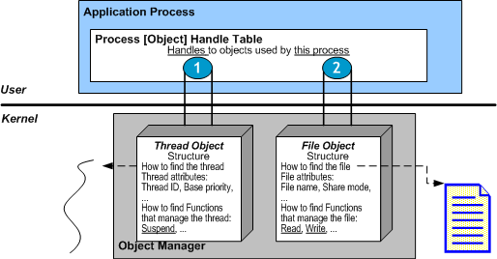
Objects in action

Slide 64
Objects Exposed By Windows
Object Type | Brief Description
Access token | An object containing rights
Desktop | A display surface for GUI elements.
Event | An object which can be used for to notify a processes .
File | An open file or an I/O device (Note that "file" is any stream of data here and not just a file system item)
Section/File mapping object | A region of memory mapped to a file.
Job | A set of processes.
Key | A registry key.
Process | A set of threads sharing the same virtual memory and other resources
Semaphore/Mutex | Objects which synchronize access to other resources.
Symbolic link | A reference to other objects - where one name "points" to another.
Thread | A single stream of code which is scheduled independently - part of a process.
Timer | An object that sends notification to a process at a given time.
WindowStation | An object that is associated with a process, and contains a clipboard, an atom table, and one or more desktop objects

Slide 65
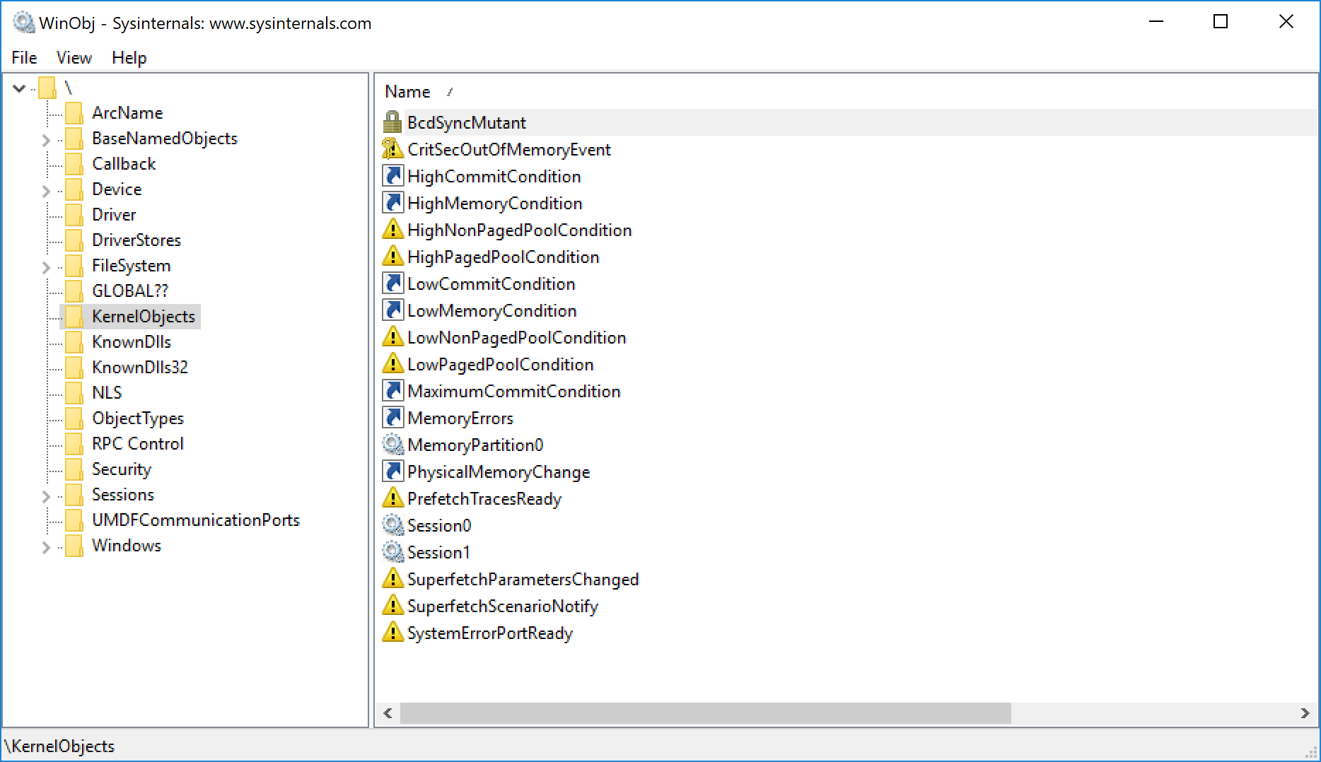
Display the content of the Object Manager
WinObj.exe allows to travel the object manager

Slide 66
Interesting Object Manager namespaces
\Device
Contains all device objects
\Drivers
Contains all driver objects
\FileSystem
Contains filesystem driver objects
\Global??\
Contains objects which can be ‘seen’ from all sessions and opened from applications
\Sessions\n\
Contains objects which are specific to session n
\ObjectTypes
All object type the Object Manager can handle

Slide 67
Interresting Debugger commands for the Object Manager
!object will dump generic object’s details
ie: attributes common to all object types
!drvobj will dump driver details
Assuming object is a driver
!devobj will dump device details
Assuming object is a device
!fileobj will dump file details
Assuming object is a file
kd> !object \Global??\Tcp
Object: ffff9989617ab680 Type: (ffff890584a64240) SymbolicLink
ObjectHeader: ffff9989617ab650 (new version)
HandleCount: 0 PointerCount: 1
Directory Object: ffff9989616049f0 Name: Tcp
Flags: 00000000 ( Local )
Target String is '\Device\Tcp’
kd> !object \FileSystem\Ntfs
Object: ffff8905859a0bb0 Type: (ffff890584b09f20) Driver
ObjectHeader: ffff8905859a0b80 (new version)
HandleCount: 0 PointerCount: 5
Directory Object: ffff9989616a8e50 Name: Ntfs
kd> !drvobj \FileSystem\Ntfs
Driver object (ffff8905859a0bb0) is for:
\FileSystem\Ntfs
Driver Extension List: (id , addr)
Device Object list:
ffff890585f25030 ffff8905859a08c0
1: kd> !drvobj \Driver\AFD

Slide 68
I/O System

Slide 69
I/O System core responsibilities
Manages communication from applications to devices
Handles dynamic insertion of devices
PnP – Plug and Play
Dynamic loading/unloading of device drivers
Handles power transitions
Sleep, Power-on, Shutdown, …

Slide 70
I/O System components
I/O Manager
Core of the I/O system. Connects applications and other system components to devices (logical, physical & virtual)
Device Drivers
Expose device functionalities to the I/O manager
PnP Manager
Respond to device addition/removal and load appropriate drivers
Power Manager
Manage power transitions for all pieces of hardware
Hardware Abstraction Layer

Slide 71
I/O Model
An I/O is an abstraction for sending orders to any kind of objects
Eg. Read a file, Open CD-ROM tray, Write a sector on disk, Light-up a keyboard LED
I/O operations are encapsulated in IRPs
1 IRP = 1 I/O order
Exception : some I/O does not use IRP. FastIO
Application and system send

Slide 72
Devices
Historically
A device was a piece of hardware that was added a computer typically through a bus
Today
Many devices are built-in to the computer
e.g. graphics controllers, network interfaces etc.
Still treated as "additional"
They are not all the same
They need software, called drivers, so that the operating system, the CPU, and other devices can communicate

Slide 73
Device Drivers
A computer program which allows higher-level computer programs (e.g. an operating system) to interact with a hardware device
Device drivers
Operate at privileged levels
Are loadable kernel mode pieces of software
In Windows, they usually have the extension .sys
Key facts
Most drivers in Windows are kernel drivers, which means that they run in shared kernel memory space
Unstable drivers can easily disrupt the whole operating systems
Signed drivers
Verify source and integrity of a driver before installing it
Microsoft enforcing testing (Windows Logo) & signing for kernel mode drivers for 64 bit OS
Unsigned drivers
Require administrative privileges to install in x86 OS

Slide 74
Common type of drivers
Hardware
File System drivers
File System Filter drivers
Network Redirectors
Kernel stream filter drivers

Slide 75
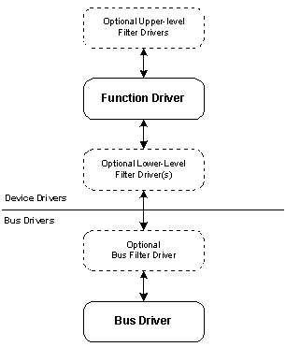
Windows Driver Model
3 types of WDM drivers
A Bus Driver
A Function Driver
A Filter Driver
No single driver controls all aspects of a device
Functions Drivers are split
Class Drivers
Written by Microsoft
Common functionality
Miniport Drivers
Written by hardware vendor
Hardware specific
As a general rule, as you go down a stack diagram it the data becomes more specific to the underlying hardware

Slide 76
WDM Layers
Consistent API for application programmers
"Hides" differences in devices
Abstracts complexity
A single call in the API can carry out a whole series of operations
e.g. setup an HTTP session with logon, TCP session, name resolution, user prompts all being carried out automatically
Simplification for application writers
Simplification for device driver writers
Often only a small "mini-port" driver is required
Writing less code by "re-use" of code in class drivers- many drivers have similar functions
Manufacturers are more likely to provide a driver if less work is required
More stable code
The middle layers of the code tend to be more robust as they are used extensively by all examples of the drivers
Code written by the most appropriate programmers
The API layer would ideally be written by an "expert" in the needs of application writers
The operating system service layers could be written by experts in the operating systems functions.
The hardware interface layer could be written by the hardware expert
Isolation
Components can be modified "in the stack" without impacting the whole

Slide 77
Structure of a Driver
Drivers are represented as internal memory structures. Main components:
Support routines
Initialization, add-device, interrupts service routines
Dispatch routines
For each major I/O family, a dispatch routine is provided. Major I/O families include Read, Write, Open, Close, …

Slide 78
Dumping driver details using the debugger
Use the !drvobj addr 7 command. Example below is for NTFS driver
kd> !drvobj \FileSystem\Ntfs 7
Driver object (ffff8905859a0bb0) is for:
\FileSystem\Ntfs
Driver Extension List: (id , addr)
Device Object list:
ffff890585f25030 ffff8905859a08c0
DriverEntry: fffff80a51892010 Ntfs!GsDriverEntry
DriverStartIo: 00000000
DriverUnload: 00000000
AddDevice: 00000000
Dispatch routines:
[00] IRP_MJ_CREATE fffff80a5173d0b0 Ntfs!NtfsFsdCreate
[01] IRP_MJ_CREATE_NAMED_PIPE fffff8026cb29740 nt!IopInvalidDeviceRequest
[02] IRP_MJ_CLOSE fffff80a5173b620 Ntfs!NtfsFsdClose
[03] IRP_MJ_READ fffff80a51674ae0 Ntfs!NtfsFsdRead
[04] IRP_MJ_WRITE fffff80a51677da0 Ntfs!NtfsFsdWrite
Command gives
Driver object address (ffff8905859a0bb0 in the example)
Any Devices which are attached to the driver
Driver’s support routines
Driver’s dispatch routines

Slide 79
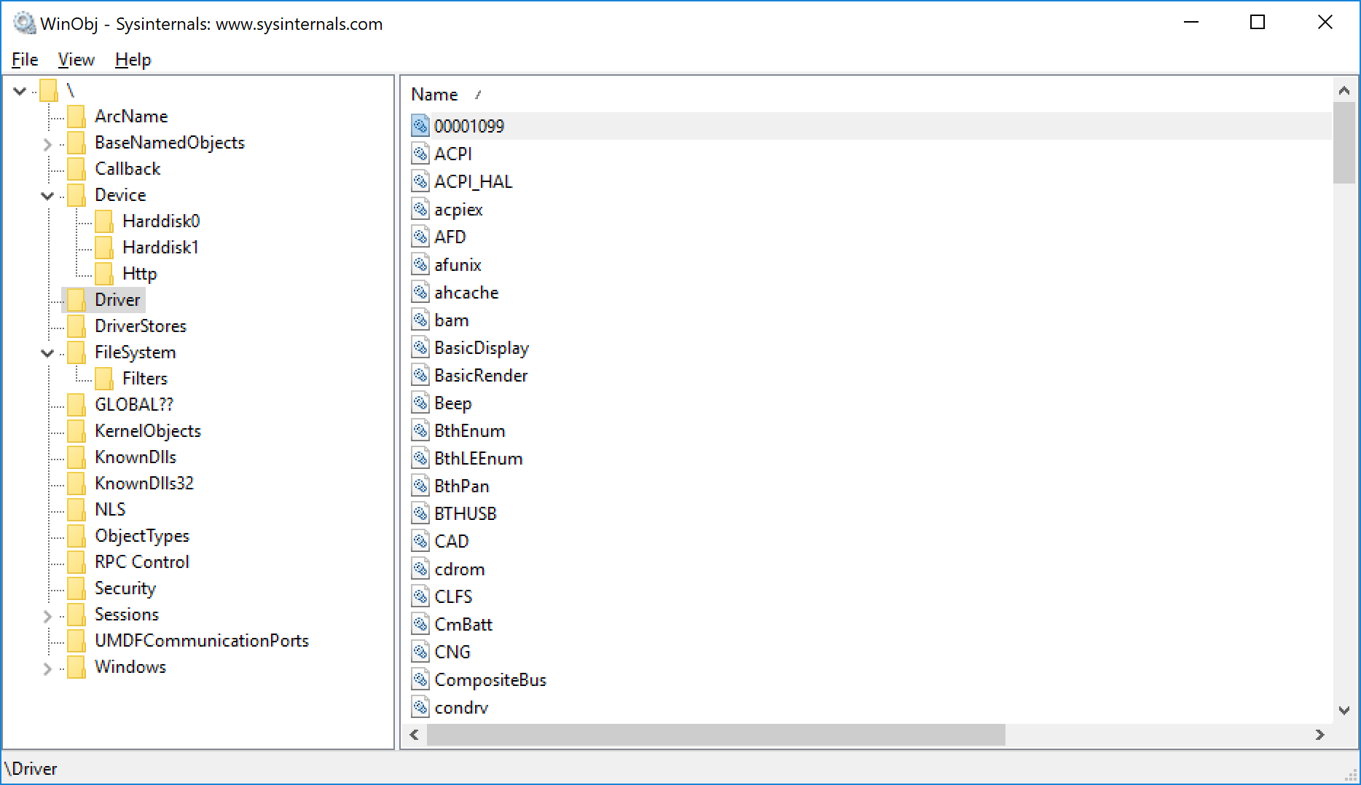
Viewing Drivers
Using WinObj.exe
Displays currently loaded drivers
Using driverquery.exe
Displays available drivers
C:\Windows\system32>driverquery.exe
Module Name Display Name Driver Type Link Date
============ ====================== ============= ======================
1394ohci 1394 OHCI Compliant Ho Kernel
3ware 3ware Kernel 19/05/2015 00:28:03
ACPI Microsoft ACPI Driver Kernel
AcpiDev ACPI Devices driver Kernel
acpiex Microsoft ACPIEx Drive Kernel
acpipagr ACPI Processor Aggrega Kernel
AcpiPmi ACPI Power Meter Drive Kernel
acpitime ACPI Wake Alarm Driver Kernel
ADP80XX ADP80XX Kernel 09/04/2015 22:49:48
AFD Ancillary Function Dri Kernel
afunix afunix Kernel
ahcache Application Compatibil Kernel

Slide 80
Drivers and Devices
Driver Objects
Represents an individual driver in the system
Contains addresses of dispatch and ISR routines
Driver objects are located in the \Driver folder
Filesystem drivers are located in \FileSystem folder
Device Objects
Represent a physical or logical device on the system
Describe various characteristics of the device
Device objects are located in the \Device folder

Slide 81
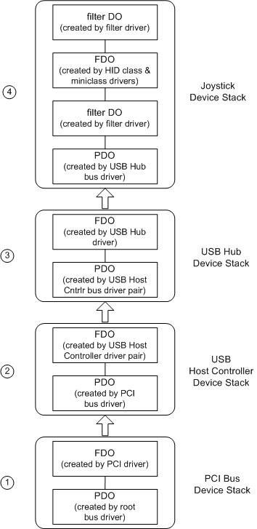
Driver Layers explained : the USB Joystick driver
Example of a Joystick driver connected to a USB port
Device Stack representing the PCI bus
Device Stack representing the USB controller connected to the PCI bus
Device Stack representing the USB root hub controller.
Usually, USB controllers always create a root Hub
Device Stack representing the Joystick device

Slide 82
Types of I/O
All I/O operations are asynchronous internally
Once an I/O request has been initiated, control returns to the I/O manager
Most applications issue synchronous I/O
Eg. An application reading a file will block until the file portion is actualy read and data available in memory
Applications can choose between synchronous and asynchronous I/O

Slide 83
Processing of an I/O
User
Kernel
IRP
IRP
3
2
At the end of processing, 1st driver calls the I/O manger to call the next driver
1
I/O Manager creates a new IRP and set the IRP stack pointer to first location
Application initiates a new I/O
Eg. A Read operation
4
Using hardware specific technics, the driver sends the order to the physical device
System Service Dispatcher
I/O Manager
Driver
Driver
Hardware
Application
7
I/O results is provided to the application
4
While the device is processing the order, driver returns STATUS_IO_PENDING
5
When device finishes processing the order, it signals an interrupt line.
I/O manager will retrieve the IRP and send it back to the driver
6
I/O manager walks back the device stack

Slide 84
Device drivers signing
Most device drivers run in the kernel
Can "do anything“
A badly behaved device driver can cause instability or even total system failure
Poorly written device drivers
Microsoft provide tools to help hardware manufacturers produce stable and well performing drivers
Deliberately "infected" device drivers
A fabulous "attack vector" (way in) for malicious code
Device drivers have almost unlimited powers so the addition of malicious code to a device driver was (and is) a popular activity

Slide 85
.
Part 3 – In-Kernel Security
Learning Objectives
Understand how security is achieved in the Windows Kernel
Acces Control
Auditing

Slide 86
Security Reference Monitor
SRM is responsible for controlling access to Kernel objects
Core responsibilities
Defines the structure of Token objects
Performs access check on kernel objects
Audits kernel object access

Slide 87
Token objects
Represent an identity
Are kernel objects
but can be manipulated some way from user-mode applications
Token object type is created when SRM initilizes
Note: Token are covered in depth in the Security Mechanism modules

Slide 88
Dumping a token using the debugger
Example of dumping the primary token of powershell.exe
kd> !process ffff890585214580 1
PROCESS ffff890585214580
SessionId: 1 Cid: 1140 Peb: c10d10e000 ParentCid: 0fc4
DirBase: 33c80000 ObjectTable: ffff9989644d7040 HandleCount: 590.
Image: powershell.exe
VadRoot ffff890587b7d010 Vads 218 Clone 0 Private 5573. Modified 86. Locked 0.
DeviceMap ffff998962921410
Token ffff998963abca70
ElapsedTime 4 Days 03:45:44.272
UserTime 00:00:00.062
KernelTime 00:00:00.078
kd> !token ffff998963abca70 1
_TOKEN 0xffff998963abca70
TS Session ID: 0x1
User: S-1-5-21-201441023-2640717268-4266869512-1001
User Groups:
00 S-1-5-21-201441023-2640717268-4266869512-513
Attributes - Mandatory Default Enabled
01 S-1-1-0
Attributes - Mandatory Default Enabled
02 S-1-5-114
Attributes - DenyOnly
03 S-1-5-32-544
Attributes - DenyOnly
04 S-1-5-32-545
Attributes - Mandatory Default Enabled
Primary Group: S-1-5-21-201441023-2640717268-4266869512-513
Privs:
19 0x000000013 SeShutdownPrivilege Attributes -
23 0x000000017 SeChangeNotifyPrivilege Attributes - Enabled Default
25 0x000000019 SeUndockPrivilege Attributes -
33 0x000000021 SeIncreaseWorkingSetPrivilege Attributes -
34 0x000000022 SeTimeZonePrivilege Attributes -
Authentication ID: (0,c04687)
Impersonation Level: Anonymous
TokenType: Primary
…

Slide 89
Object Manager Access Control
Object Manager and SRM enforce access control using Security Descriptors
Security Descriptors contain list of permissions (ACEs) applicable to the owning object.
Note: Access Control and ACLs are covered in depth in the Security Mechanism modules

Slide 90
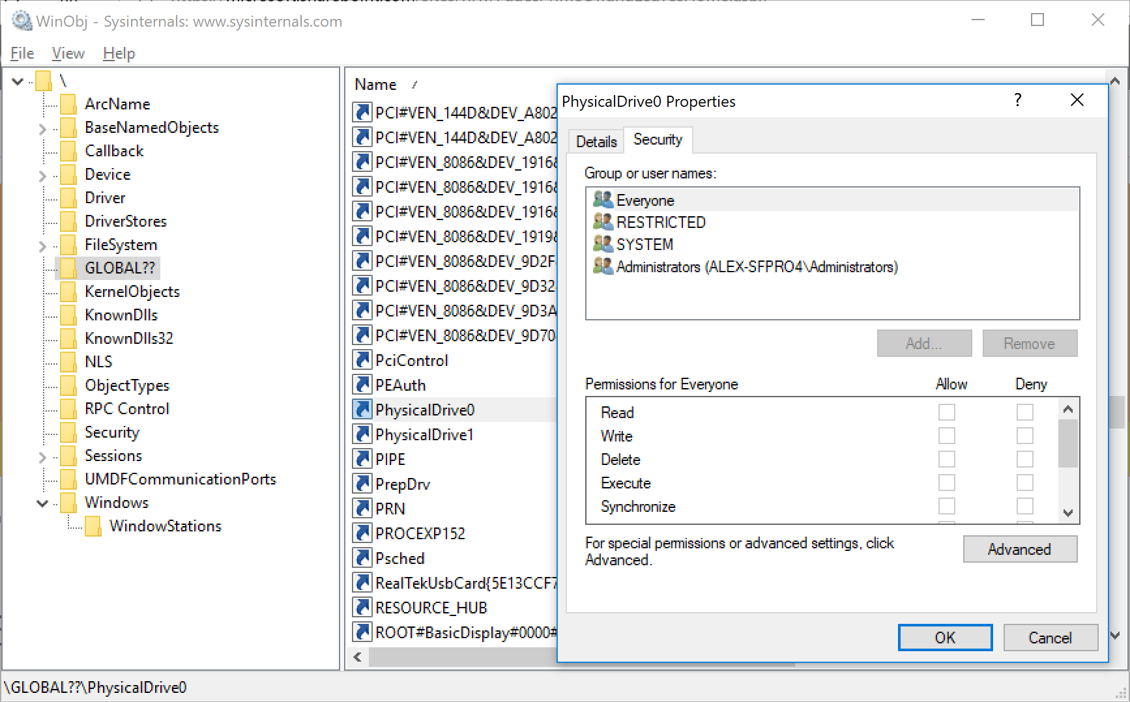
Displaying the security descriptor of an object
Using WinObj.exe
Select an object and display Properties window.
Below is an example of the first harddrive in a machine
Using the debugger
Use the !sd addr command followed by address of security descriptor
Command !sd addr 1 will try its best to translate SID to names
kd> !sd 0xffff9989`64247d60 1
->Revision: 0x1
->Sbz1 : 0x0
->Control : 0x8814
SE_DACL_PRESENT
SE_SACL_PRESENT
SE_SACL_AUTO_INHERITED
SE_SELF_RELATIVE
->Owner : S-1-5-21-201441023-2640717268-4266869512-1001 (no name mapped)
->Group : S-1-5-21-201441023-2640717268-4266869512-513 (no name mapped)
->Dacl :
->Dacl : ->AclRevision: 0x2
->Dacl : ->Sbz1 : 0x0
->Dacl : ->AclSize : 0x5c
->Dacl : ->AceCount : 0x3
->Dacl : ->Sbz2 : 0x0
->Dacl : ->Ace[0]: ->AceType: ACCESS_ALLOWED_ACE_TYPE
->Dacl : ->Ace[0]: ->AceFlags: 0x0
->Dacl : ->Ace[0]: ->AceSize: 0x24
->Dacl : ->Ace[0]: ->Mask : 0x001fffff
->Dacl : ->Ace[0]: ->SID: S-1-5-21-201441023-2640717268-4266869512-1001 (no name mapped)
->Dacl : ->Ace[1]: ->AceType: ACCESS_ALLOWED_ACE_TYPE
->Dacl : ->Ace[1]: ->AceFlags: 0x0
->Dacl : ->Ace[1]: ->AceSize: 0x14
->Dacl : ->Ace[1]: ->Mask : 0x001fffff
->Dacl : ->Ace[1]: ->SID: S-1-5-18 (Well Known Group: NT AUTHORITY\SYSTEM)

Slide 91
Displaying object’s security descriptor – detailed example
Example for a process object
kd> !process ffff890585214580 0
PROCESS ffff890585214580
SessionId: 1 Cid: 1140 Peb: c10d10e000 ParentCid: 0fc4
DirBase: 33c80000 ObjectTable: ffff9989644d7040 HandleCount: 590.
Image: powershell.exe
Step 1 – getting address of object’s header
kd> !object ffff890585214580
Object: ffff890585214580 Type: (ffff890584a5ba50) Process
ObjectHeader: ffff890585214550 (new version)
HandleCount: 11 PointerCount: 360191
Step 2 – get address of Security Descriptor
kd> dt nt!_OBJECT_HEADER ffff890585214550
<omitted for brievity>
+0x028 SecurityDescriptor : 0xffff9989`64247d62 Void
+0x030 Body : _QUAD
Step 3 – dump the Security Descriptor
kd> !sd 0xffff9989`64247d62&0n-16 1
->Revision: 0x1
->Sbz1 : 0x0
mapped)
(continuation)
->Control : 0x8814
SE_DACL_PRESENT
SE_SACL_PRESENT
SE_SACL_AUTO_INHERITED
SE_SELF_RELATIVE
->Owner : S-1-5-21-201441023-2640717268-4266869512-1001 (no name mapped)
->Group : S-1-5-21-201441023-2640717268-4266869512-513 (no name mapped)
<omitted for brievity>
Note:
On 64-bits machines, the last 4 bits of Object’s address have special meaning and need to be zeroed in order to access the object
The syntax 0xffff9989`64247d62&0n-16 helps zeroing the last 4 bits by performing a bitwise AND between address and -16 (which is ffffffff`fffffff0 in hex)

Slide 92
Auditing
Object Manager and SRM can audit object access
Object Creation/Modification/Removal
Eg. Process creation, Thread termination, Object handle creation
Privilege use

Slide 93
Auditing flow
LSA Subsystem (lsass.exe) is responsible for storing auditing events to log file
SRM uses a special communication port for sending events to LSA
This port is created early in the boot sequence so that only LSA can attach
LsaSS.exe
Event Logger
Security Event Log
Configuration
User-mode
Event
Messages
Kernel-mode
SRM

